Slide 1
Growth and the Environment
Productivity
The Environmental Kuznets Curve
International
Trade
Intertemporal
Policy implications
Within countries
Environmental justice

Slide 2
0 Introduction
1 Social choice
2 Externalities and public goods
3 Decision analysis
4 Valuation: Aims and purpose
5 Valuation: Revealed preferences
6 Valuation: Stated preferences
7 Direct regulation
8 Market-based instruments
9 Complications with instruments
10 Growth and the environment
11 Green accounting

Slide 3
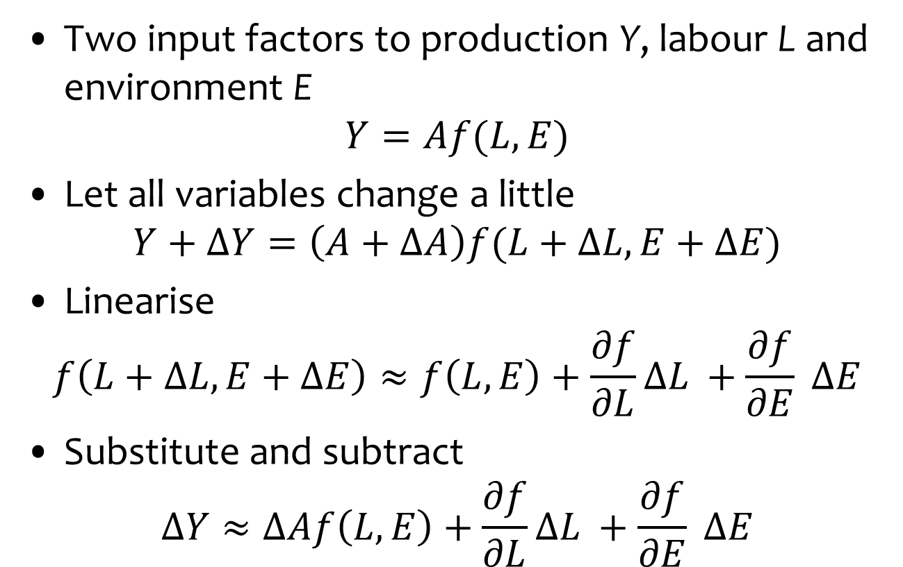
Measuring Productivity Growth
Two input factors to production Y, labour L and environment E
$$Y=Af(L,E)$$
Let all variables change a little
$$Y+ΔY=\left(A+ΔA\right)f(L+ΔL,E+ΔE)$$
Linearise
$$f\left(L+ΔL,E+ΔE\right)≈f\left(L,E\right)+\frac{∂f}{∂L}ΔL +\frac{∂f}{∂E} ΔE$$
Substitute and subtract
$$ΔY≈ΔAf\left(L,E\right)+\frac{∂f}{∂L}ΔL +\frac{∂f}{∂E} ΔE$$

Slide 4
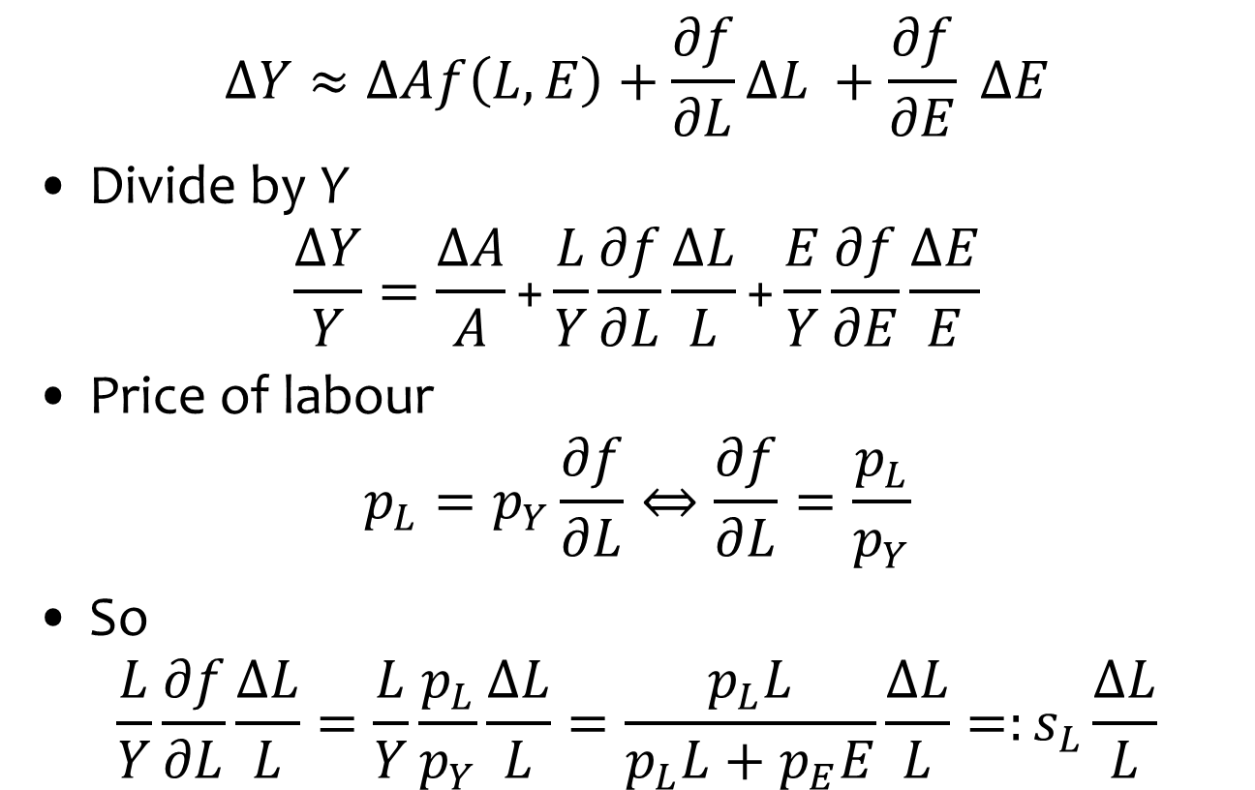
Measuring Productivity Growth
$$ΔY≈ΔAf\left(L,E\right)+\frac{∂f}{∂L}ΔL +\frac{∂f}{∂E} ΔE$$
Divide by Y
$$\frac{ΔY}{Y}=\frac{ΔA}{A}\text{+}\frac{L}{Y}\frac{∂f}{∂L}\frac{ΔL}{L}\text{+}\frac{E}{Y}\frac{∂f}{∂E}\frac{ΔE}{E}$$
Price of labour
$$p_{L}=p_{Y}\frac{∂f}{∂L}⇔\frac{∂f}{∂L}=\frac{p_{L}}{p_{Y}}$$
So
$$\frac{L}{Y}\frac{∂f}{∂L}\frac{ΔL}{L}=\frac{L}{Y}\frac{p_{L}}{p_{Y}}\frac{ΔL}{L}=\frac{p_{L}L}{p_{L}L+p_{E}E}\frac{ΔL}{L}=:s_{L}\frac{ΔL}{L}$$

Slide 5
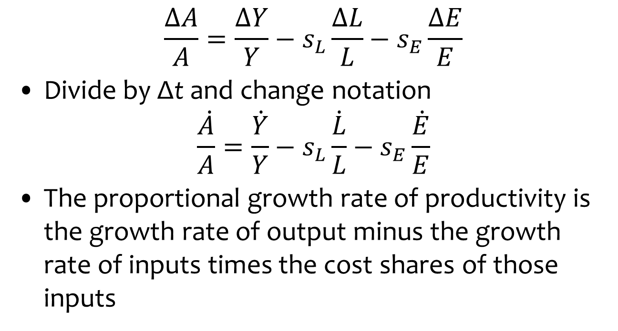
Measuring Productivity Growth
$$\frac{ΔA}{A}=\frac{ΔY}{Y}−s_{L}\frac{ΔL}{L}−s_{E}\frac{ΔE}{E}$$
Divide by Δt and change notation
$$\frac{\dot{A}}{A}=\frac{\dot{Y}}{Y}−s_{L}\frac{\dot{L}}{L}−s_{E}\frac{\dot{E}}{E}$$
The proportional growth rate of productivity is the growth rate of output minus the growth rate of inputs times the cost shares of those inputs

Slide 6
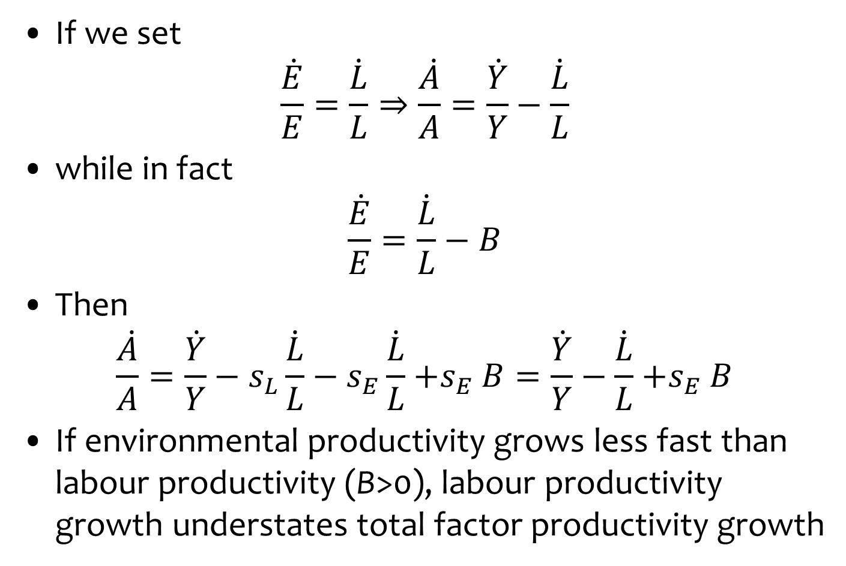
Mismeasuring Productivity Growth
If we set
$$\frac{\dot{E}}{E}=\frac{\dot{L}}{L}⇒\frac{\dot{A}}{A}=\frac{\dot{Y}}{Y}−\frac{\dot{L}}{L}$$
while in fact
$$\frac{\dot{E}}{E}=\frac{\dot{L}}{L}−B$$
Then
$$\frac{\dot{A}}{A}=\frac{\dot{Y}}{Y}−s_{L}\frac{\dot{L}}{L}−s_{E}\frac{\dot{L}}{L}{+s}_{E}B=\frac{\dot{Y}}{Y}−\frac{\dot{L}}{L}{+s}_{E}B$$
If environmental productivity grows less fast than labour productivity (B>0), labour productivity growth understates total factor productivity growth

Slide 7
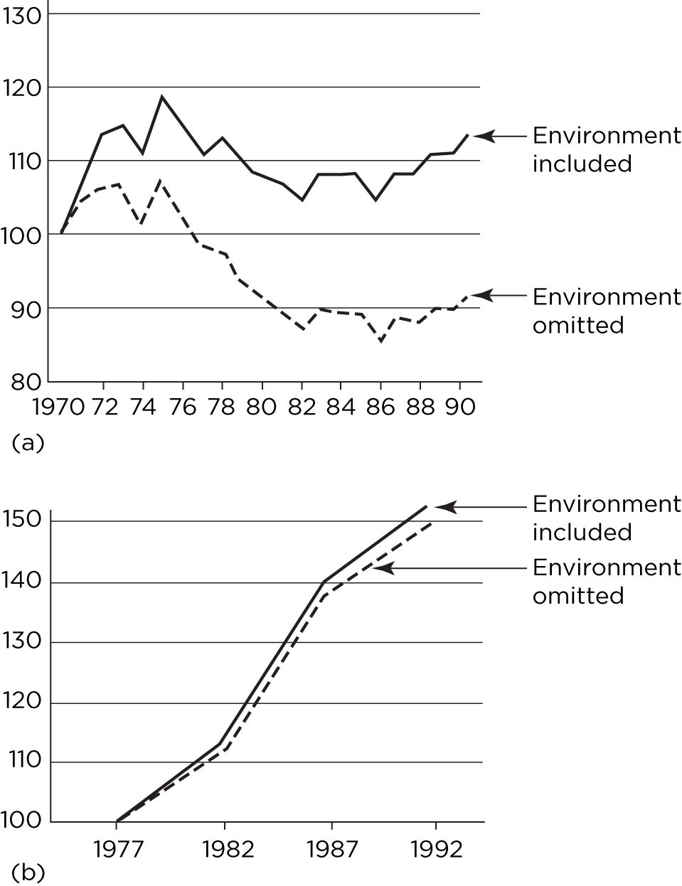

Total factor productivity
growth, with and without
environment, by sector
(top: electricity, bottom:
agriculture), USA
Growth is faster if
environment included.

Slide 8
Environmental Kuznets Curve
International
Trade
Intertemporal
Policy implications
Within countries

Slide 9
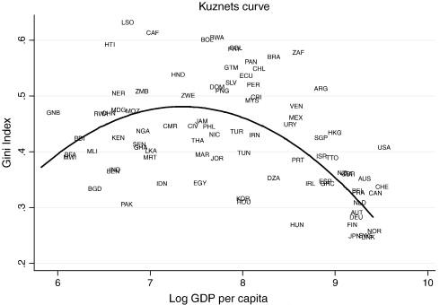
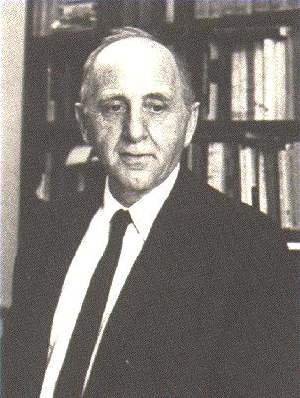
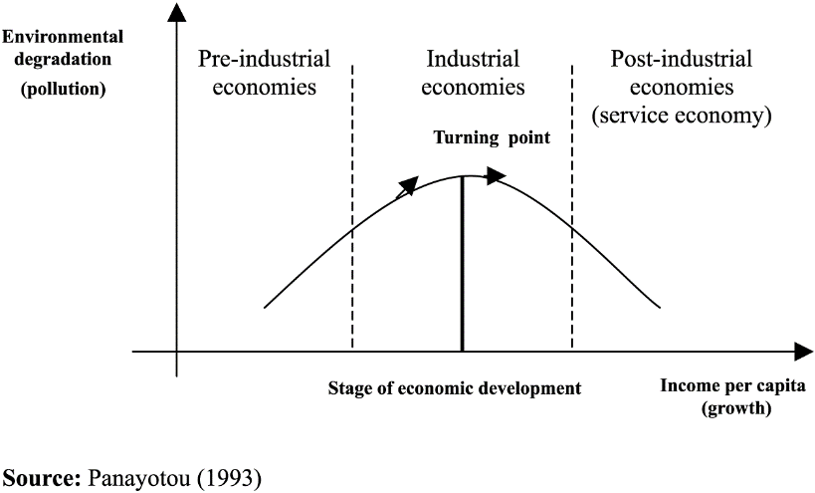

Slide 10




Slide 11
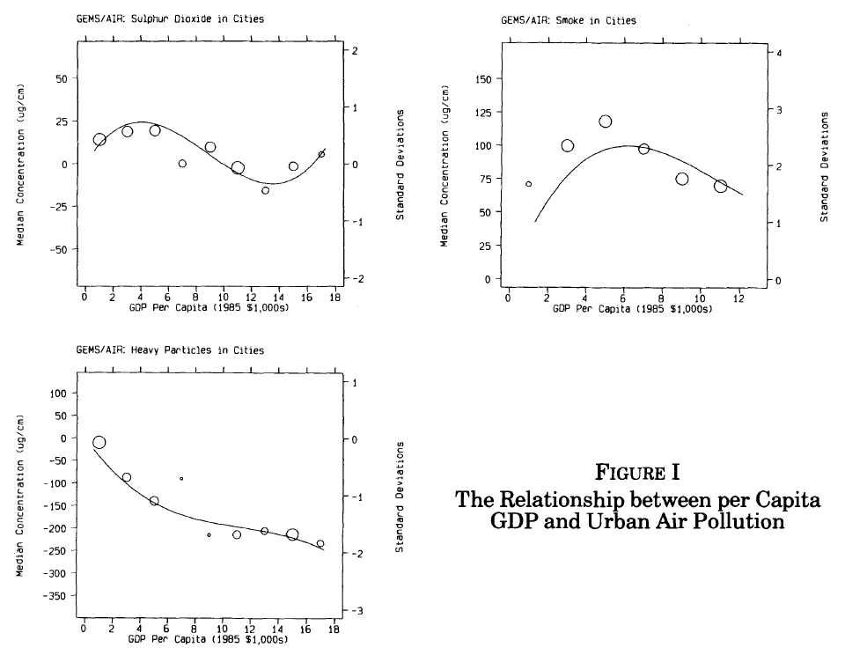

Slide 12
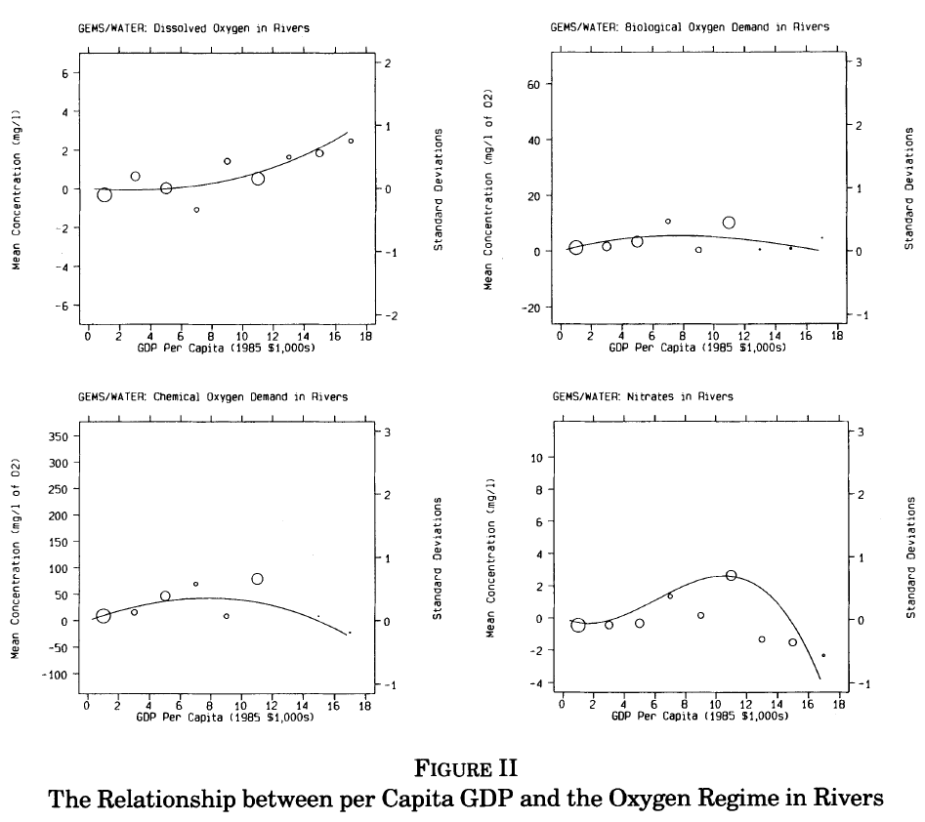

Slide 13
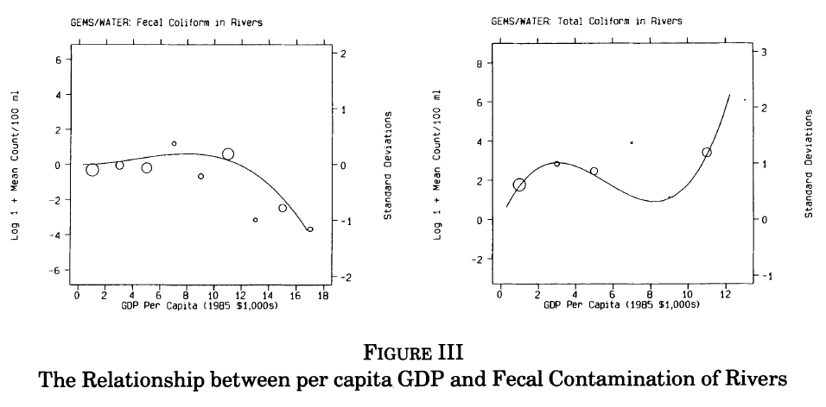

Slide 14
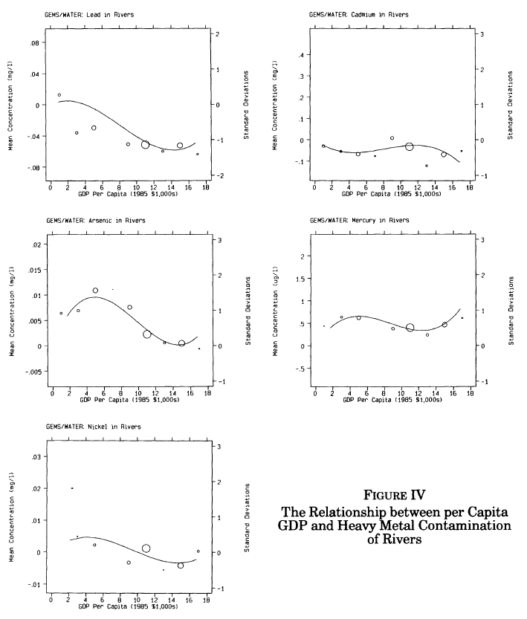

Slide 15
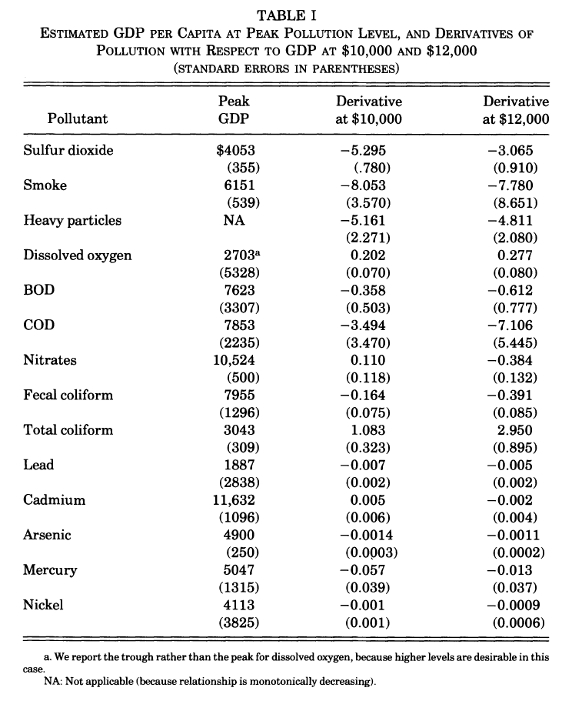

Slide 16


Environmental Kuznets Curve
The Grossman-Krueger (1991, 1995) papers spawned a large literature
Indicators of environmental quality
Countries and regions
Time periods
Specifications
Estimators
Stern “the rise and fall of the EKC”
Galeotti “desperately seeking the EKC”

Slide 17
Growth and the Environment
Ambiguous results unsurprising
Economic growth has a number of effects
Scale – more, more, more
Composition – agriculture, manufacturing, services
Technology – improved efficiency, new things
Demand – for a cleaner environment
Governance – improved delivery, but longer deliberation

Slide 18
Environmental Kuznets Curve -2
Local pollutants harmful to human health indeed tend to rise then fall with economic development, but the turning point is different for different contaminants, countries, periods
For global issues, no Environmental Kuznets Curve in sight – or at least not for totals

Slide 19
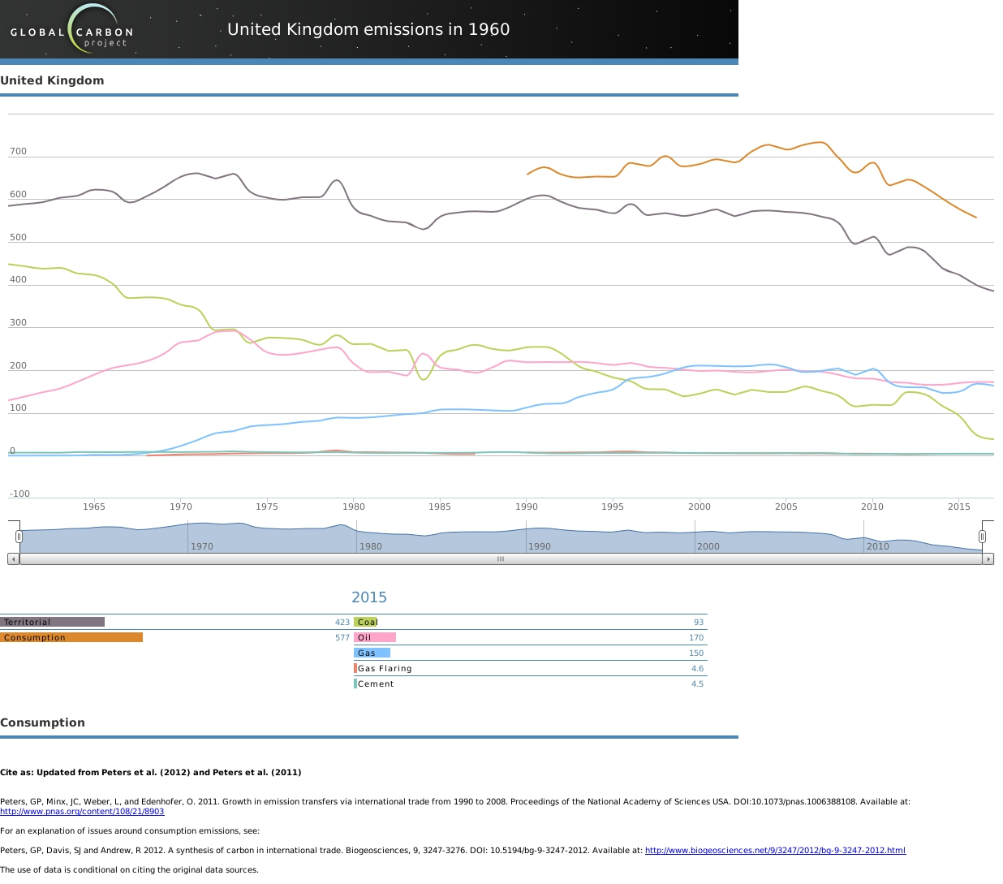
So far, we assumed a closed economy

Slide 20
Trade affects
production &
consumption
and so
emissions &
environmental
Kuznets curve.

Slide 21
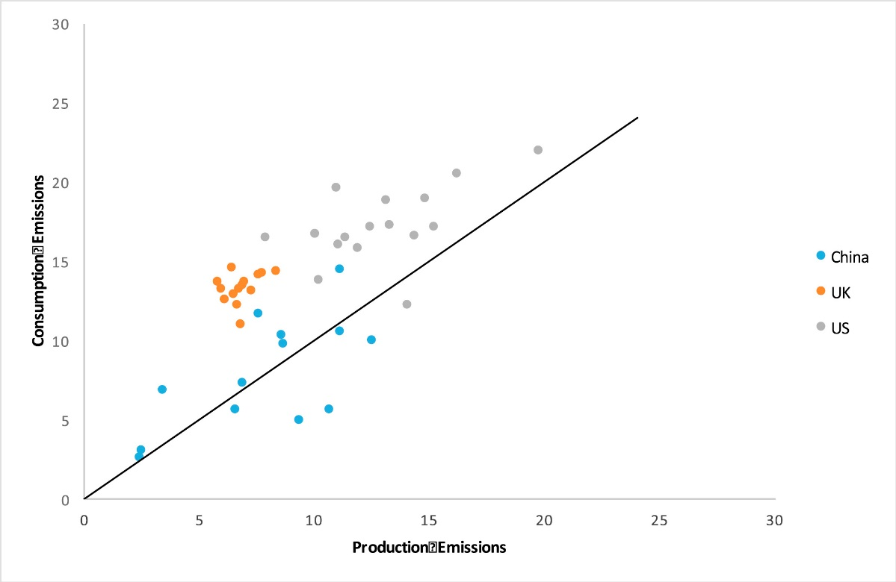
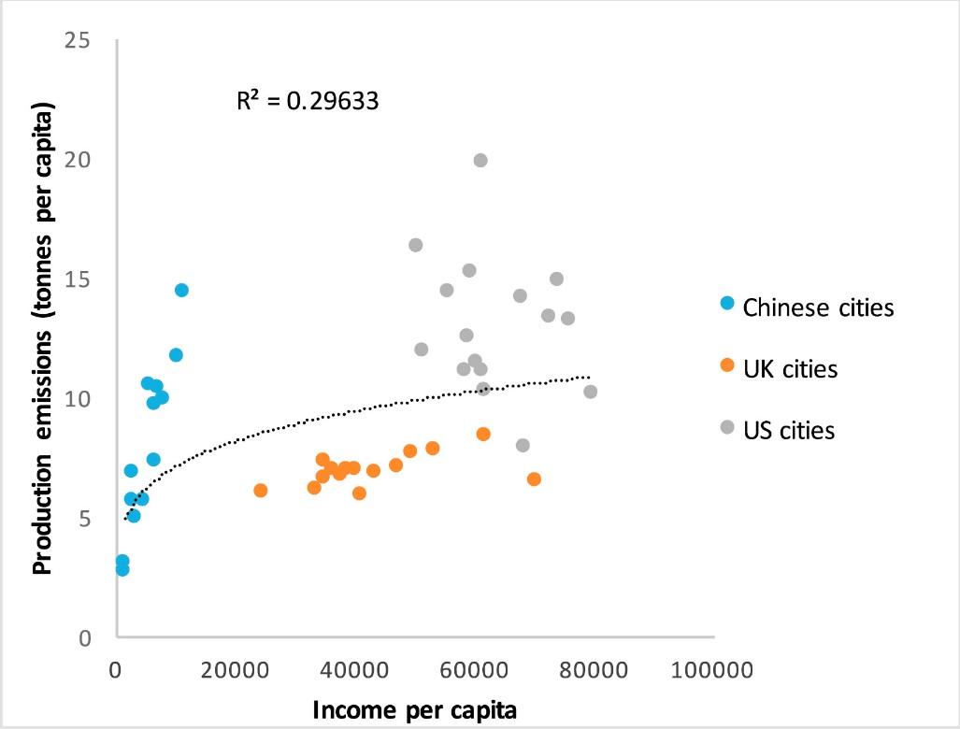
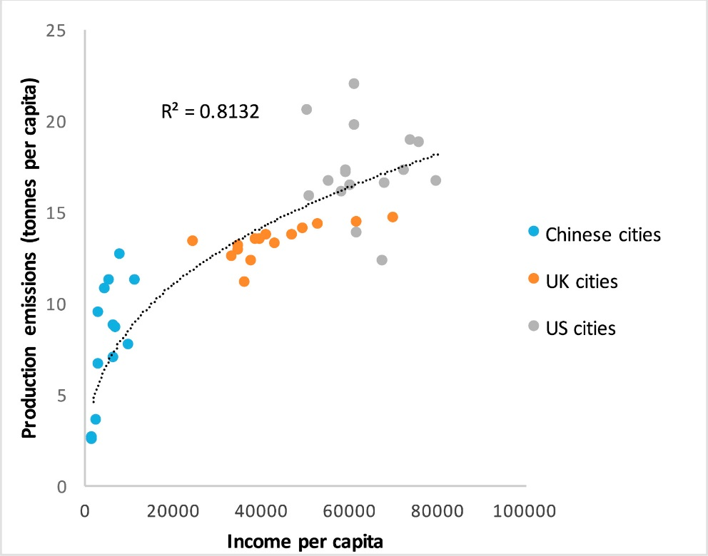
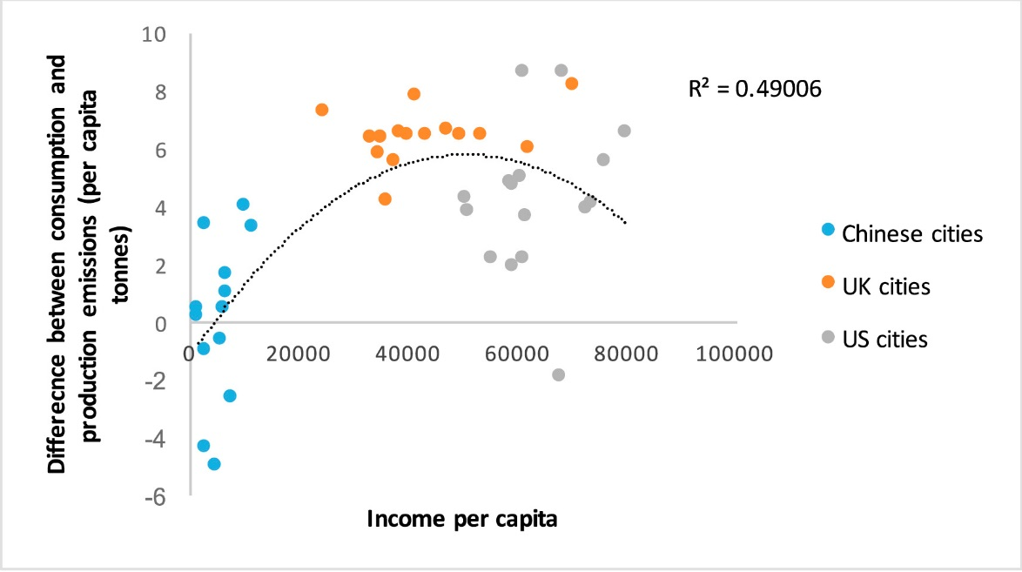
Consumption

Slide 22
International Trade
International trade further complicates the analysis of the Environmental Kuznets Curve
It is easy, indeed tempting, to mistake offshoring of production and hence pollution for a clean-up
Trends in exporting, assembling, and transit countries need similar care in their interpretation
Recent studies look at the long run

Slide 23
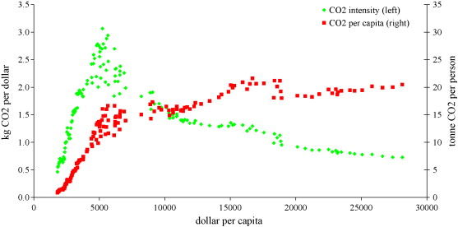
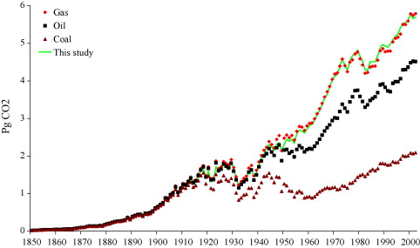

Slide 24
Policy Implications
The Environmental Kuznets Curve suggests a policy implication: Grow rich and all will be fine
However, the EKC is an association, no suggestion of a causal relationship
Let’s look at cycling

Slide 25
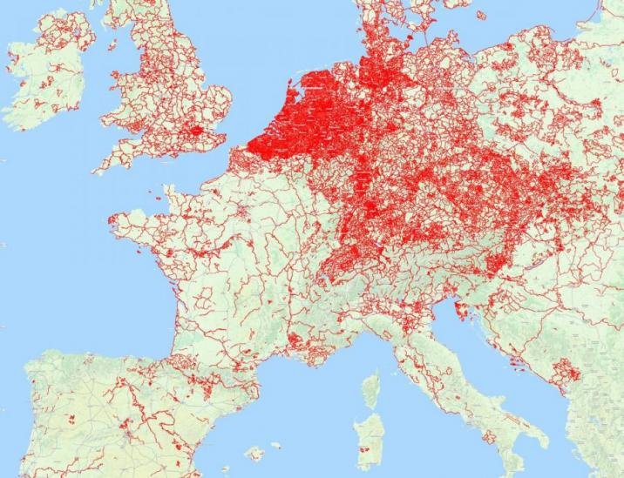
Cycle paths

Slide 26
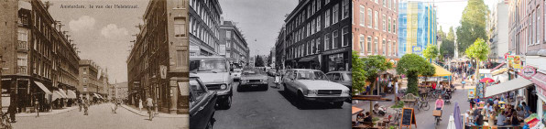
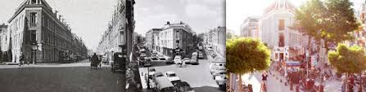

Slide 27
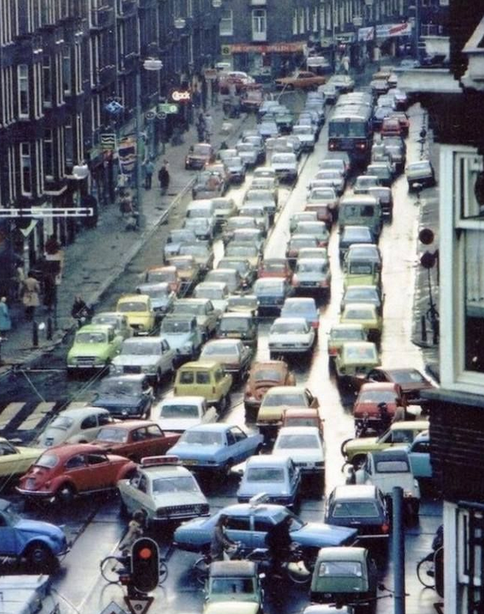
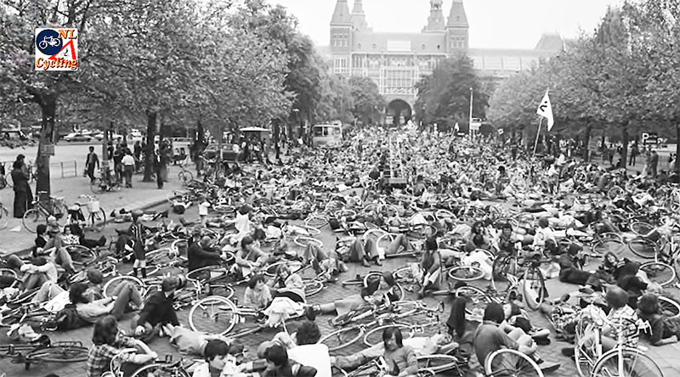
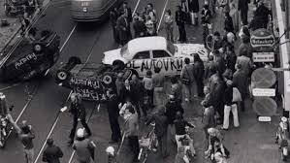
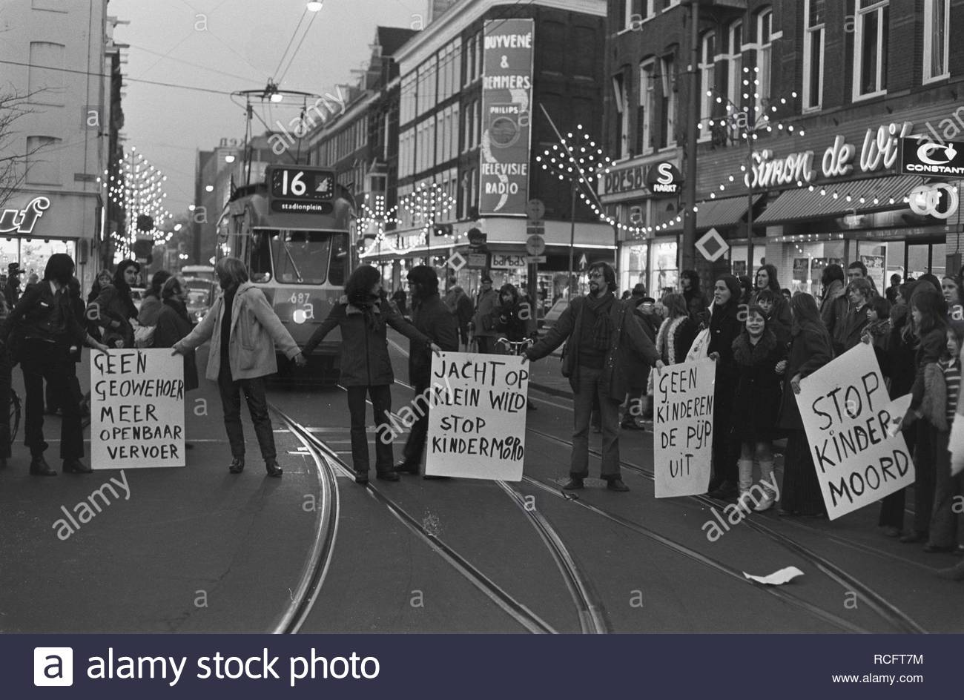

Slide 28
Policy Implications
The Environmental Kuznets Curve suggests a policy implication: Grow rich and all will be fine
However, the EKC is an association, no suggestion of a causal relationship
Environmental clean-up requires policy intervention
What about distributional issues?

Slide 29
Poorer people drive older cars,
richer people drive more with heavier cars.

Slide 30
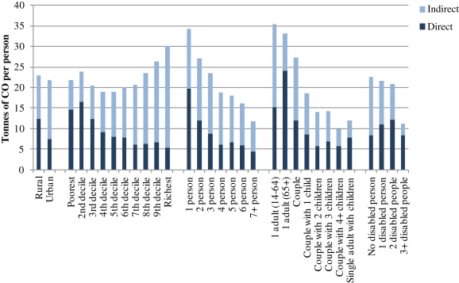
Environmental Justice
Pressure on the environment is different for different socio-economic groups

Slide 31
Environmental Justice
Pressure on the environment is different for different socio-economic groups
Incidence of environmental policy is therefore different for different groups
Concerns about environmental justice do not stop there

Slide 32
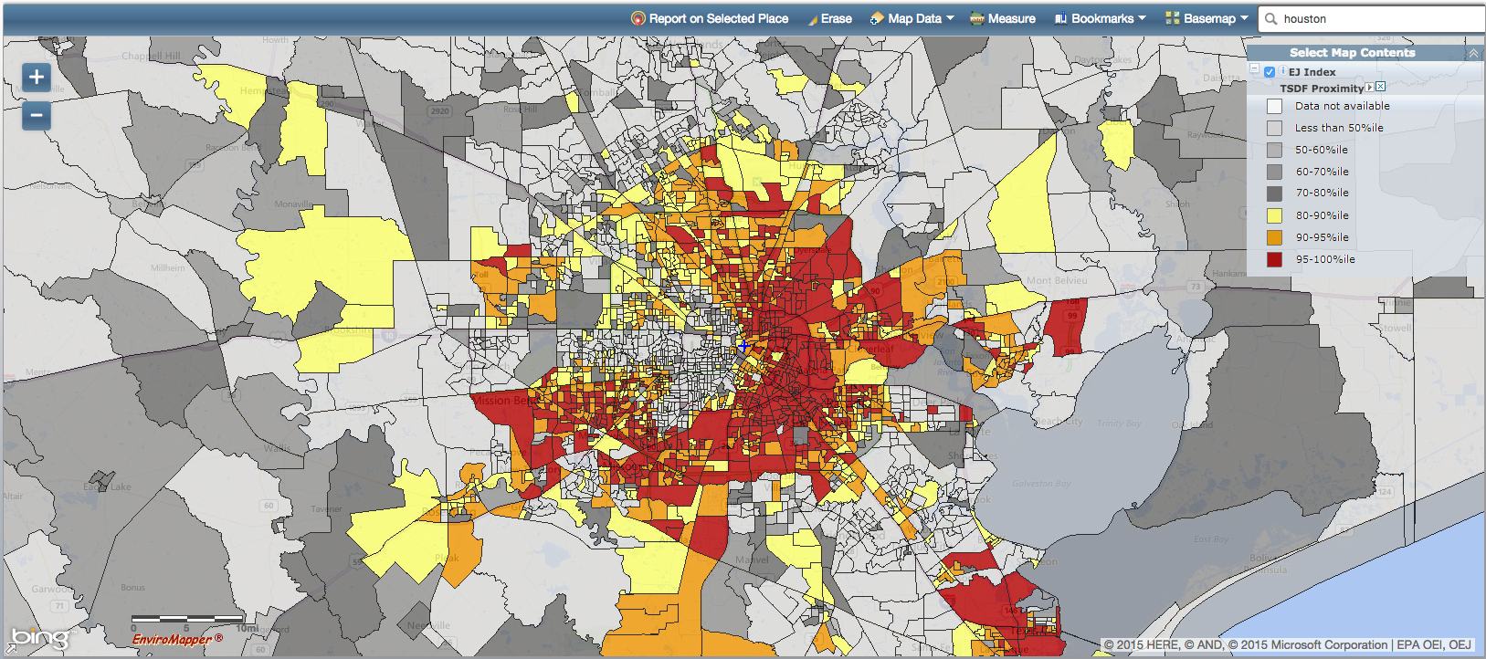
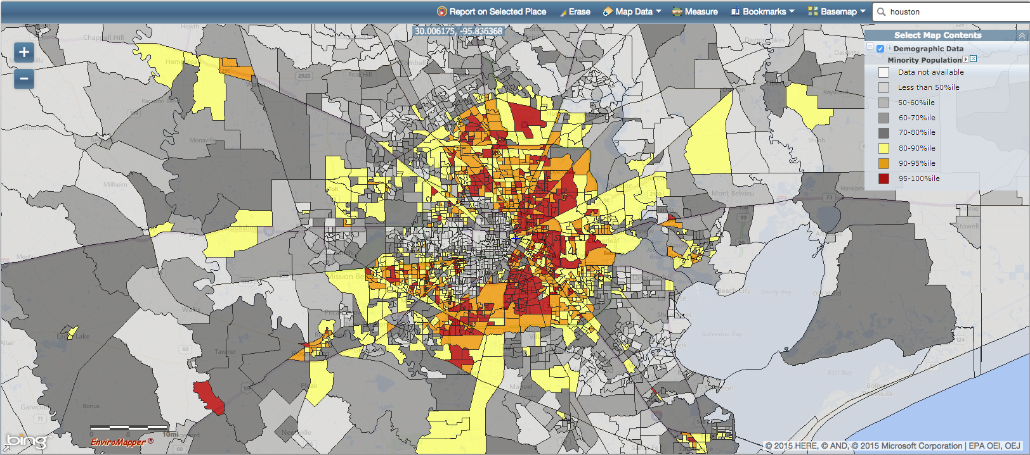
Houston
waste
minorities

Slide 35

London air pollution
particularly hits the poor,
so congestion charges
primarily benefitted the
poor.

Slide 36
Environmental Justice
Pressure on the environment is different for different socio-economic groups
Incidence of environmental policy is therefore different for different groups
Environmental hazards tend to be sited near the poor and deprived
House prices are lower near environmental hazards, attracting the poor and deprived

